Slide 1
Cornell SEBA
Science and
Engineering
Business
Association
General Body Meeting
April 4, 2012

Slide 2
accounting

Slide 3
Major financial statements
Balance Sheet
Assets = Liabilities + Stockholder’s Equity
Income Statement
Revenues – Expenses = Net Income
Cash Flow Statement
Cash Inflow – Cash Outflow = Net Cash

Slide 4
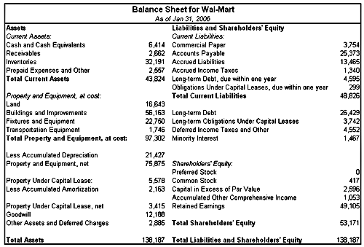

Slide 5
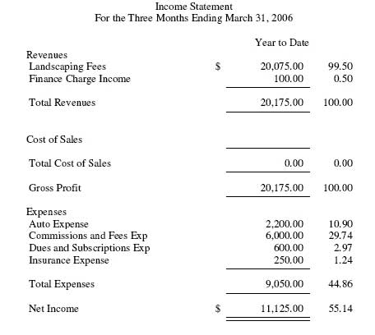

Slide 6
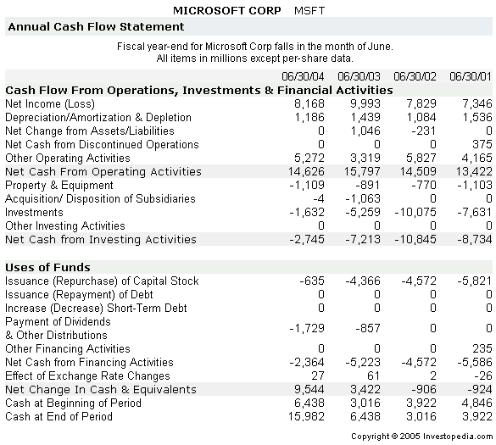

Slide 7
Basic accounting terms
EBITDA: Earnings Before Interest, Taxes, Depreciation, Amortization
Depreciation: write-down in value of a tangible asset
Amortization: write-down in value of an intangible asset
Gross Margin = Revenues – COGS (or cost of revenues)
Working Capital = Current Assets – Current Liabilities
Revenues are recorded when earned and expenses are recorded when incurred.
Period ends December 31, 2011
Incur expense on December 30, 2011, don’t pay until 2012

Slide 8
Statements are connected
Net Cash from Cash Flow Statement flows into Cash account on Balance Sheet
Net Income flows into Stockholder’s Equity account on Balance Sheet and first account on Cash Flow statement

Slide 9
Potential problems
What is counted as revenue?
Earnings solely based on accounting changes are not “quality earnings”
Footnotes in financial reports (movement of accounts)
High growth of debt, high growth of accounts receivables

Slide 10
Standard ratios
Current Ratio = Current Assets / Current Liabilities
Test liquidity
Quick Ratio = (Cash + Short-term Investments + Accounts receivables) / Current liabilities
Test liquidity
Debt Ratio = Total Debt / Total Assets
Leverage
Debt-to-Equity Ratio = Total Debt / Total Equity
Capital structure
Leverage

Slide 11
Valuation ratios
P/E Ratio = Current Price per share / Earnings per share
PEG Ratio = P/E Ratio / Est. growth as a percentage
P/BV Ratio = Stock Price per share / Shareholder’s Equity per share
Dividend Yield = Annual Dividend per share / Stock price per share

Slide 12
finance

Slide 13
What is a dcf?
A Discounted Cash Flow is a way of determining the value of a company by trying to predict their future cash flows. (How much money are they going to be making in the future?)

Slide 14
1. Calculate free cash flow
Free Cash Flow is calculated by taking:
EBIT
Less Taxes
Less Capital Expenditures
Less Net Change in Working Capital
Plus Depreciation and Amortization
= Free Cash Flow

Slide 15
2. Make assumptions
Predict growth in revenues, expenses, etc.
Usually project the data out for the next five to ten years
Look at past figures to make most accurate assumptions

Slide 16
3. Terminal Value
Terminal Value is determined by looking at the potential growth of the company AFTER the projection period.
Terminal Growth is calculated using the Gordon Growth Model.
Gordon Growth Model:
FCF at time 5 = FCF at time 6 / (Cost of Equity – Growth Rate)
Growth rate is usually the average growth rate of U.S. GDP

Slide 17
4. Discount rate
The discount rate is the value used to find the NPV of the firm
The proper discount rate is the Weighted Average Cost of Capital of a firm (WACC)
WACC =
(1-t)k_{d}(D/Total Capital) + k_{e}(SE/Total Capital) + k_{p}(P/Total Capital)
How to find k_{d}, k_{e}, and k_{p}?

Slide 18
5. CAPM
To find cost of equity, utilize Capital Asset Pricing Model.
CAPM = R_{f} + B_{L}(Market Risk Premium)
Market Risk Premium = Expected Return on Equity – R_{f}
R_{f} = risk free rate (interest rate paid on 10-year US Treasury bond)
B_{L} = Beta that you find on website x (1 + ((1 – Tax Rate) x (Debt/Equity)))

Slide 19
6. Combine values
Now, you can calculate WACC, which will give you the rate at which you need to discount all your cash flows.
Discount everything back to time 0 (present time) and you have your enterprise value!
However, enterprise value =/= market cap.
Enterprise Value + Debt Outstanding – Cash = Market Cap

Slide 20
7. valuation
What is the hypothetical share price?
Market Cap / Outstanding Common Stock
= Predicted Stock Price
Compare to current market price of stock
Undervalued? Overvalued?

Slide 21
Courses

Slide 22
AEM courses
AEM 1200- Business Management
AEM 2210- Financial Accounting
ORIE 3150- Accounting
AEM 2400- Marketing
AEM 3240- Finance

Slide 23
Econ courses
Econ 1110- Intro to Microeconomics
Econ 1120- Intro to Macroeconomics
Econ 3010- Microeconomics
Econ 3020- Macroeconomics (spring only)
Econ 3130- Intermediate Microeconomics
Econ 3140- Intermediate Macroeconomics

Slide 24
Johnson school courses
NCC 5500- Financial Accounting
NCC 5530- Marketing Management
NCC 5560- Managerial Finance
NBA 5070- Entrepreneurship for Scientists and Engineers

